Slide 1
FACTOR BY GROUPING

Slide 2
STEPS TO FACTOR BY GROUPING (4 TERMS)
Put the first two in parentheses and find the GCF
Put the last two in parentheses and find the GCF
Look for matching parentheses (twins)
Rewrite answer

Slide 3

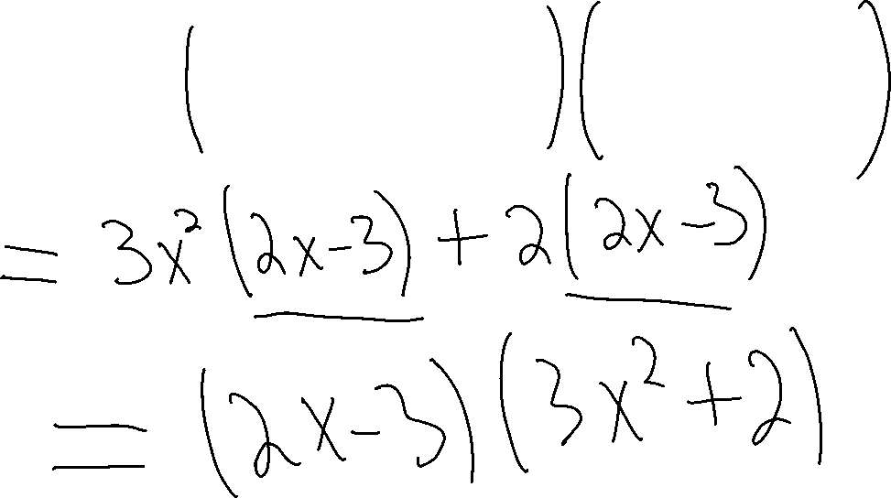
EX.1
$$6x^{3}−9x^{2}+4x−6$$

Slide 4

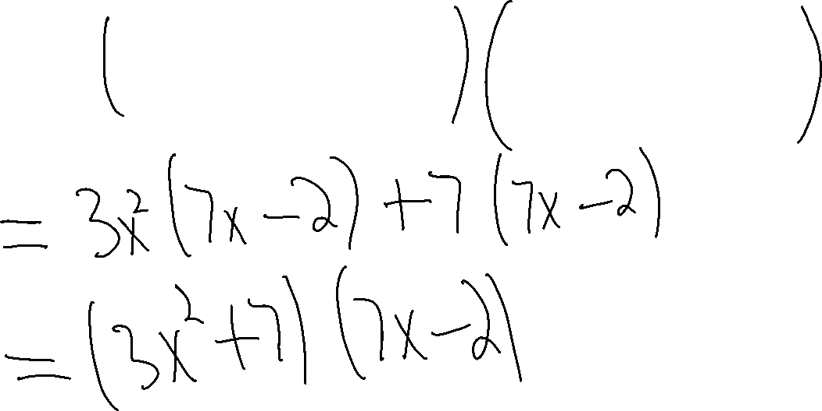
EX.2
$$21x^{3}−6x^{2}+49x−14$$

Slide 5


EX.3
$x^{3}+2x^{2}−x−2$

Slide 6

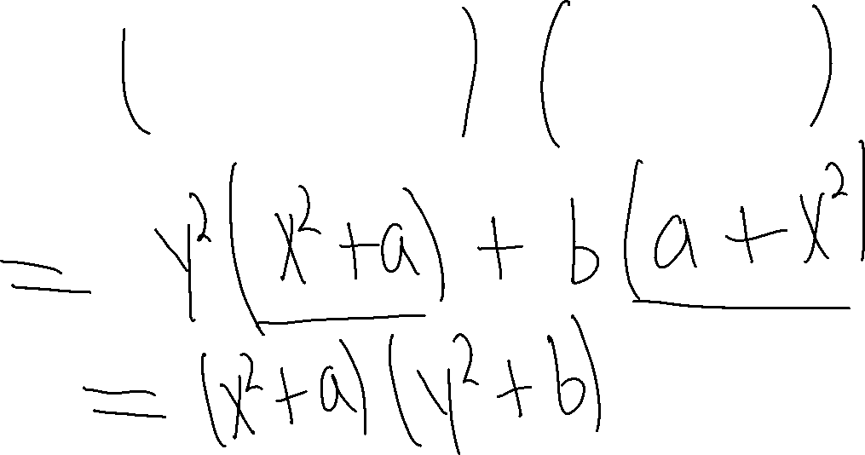
EX.4
$x^{2}y^{2}+ay^{2}+ab+bx^{2}$

Slide 7

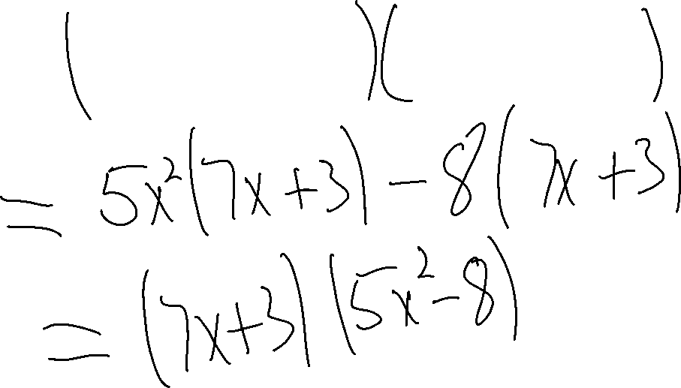
EX.5
$$35x^{3}+15x^{2}−56x−24$$

Slide 8

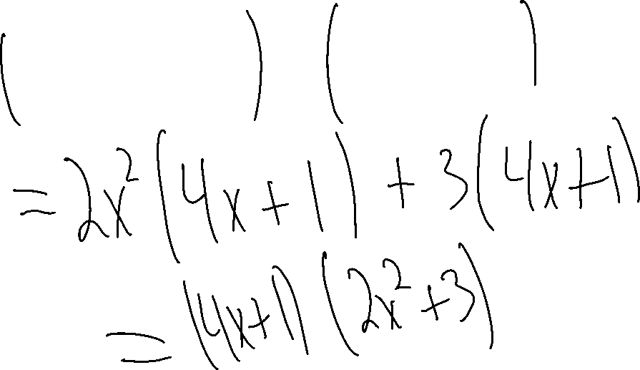
EX.6
$$8x^{3}+2x^{2}+12x+3$$

Slide 9

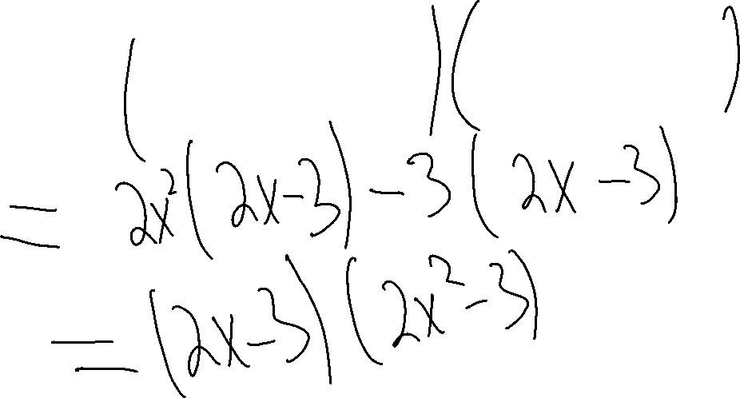
EX.7
$$4x^{3}−6x^{2}−6x+9$$

Slide 10

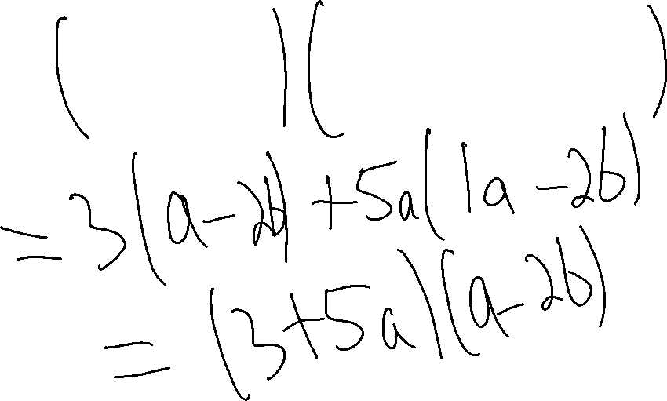
EX.8
$$3a−6b+5a^{2}−10ab$$

